Slide 1


BIG DATA ANALYTICS (CS-431)
Dr. Sriparna Saha
Associate Professor
Website: https://www.iitp.ac.in/~sriparna/
Google Scholar: https://scholar.google.co.in/citations?user=Fj7jA_AAAAAJ&hl=en
Research Lab: SS_Lab
Core Research AREA: NLP, GenAI, LLMs, VLMs, Multimodality, Meta-Learning, Health Care, FinTech, Conversational Agents
TAs: Sarmistha Das, Nitish Kumar, Divyanshu Singh, Aditya Bhagat, Harsh Raj

Slide 2

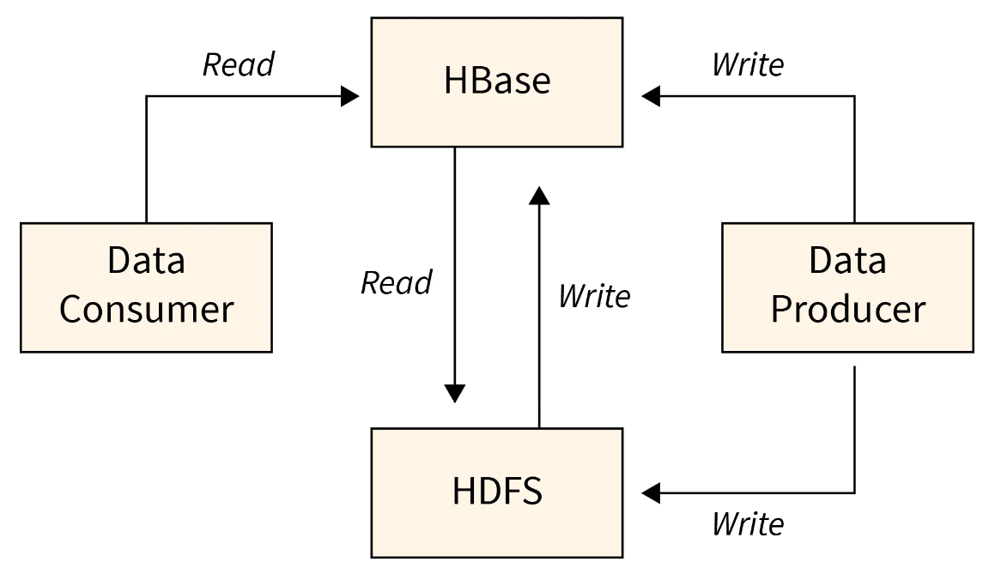
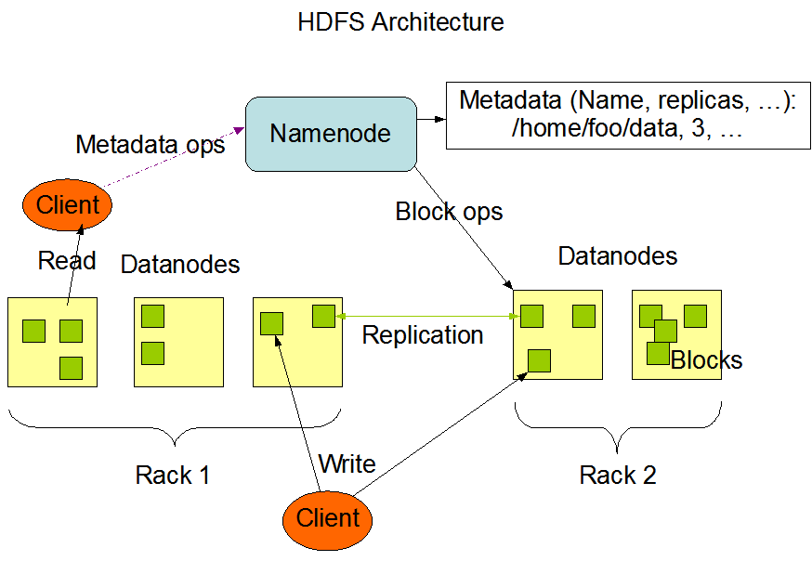
What is Apache HBase?
HBase is a NoSQL, column-oriented database that runs on top of HDFS. It provides real-time read/write access to large datasets.
Key Points:
Built on top of HDFS (HDFS is the primary distributed file system used by Hadoop to store large volumes of data across multiple machines. It is designed for high-throughput access to large files.), uses it for storage.
Ideal for random, real-time access to big data
Suitable for use cases like messaging platforms, analytics engines, etc.
Schema-less, supports millions of rows and columns.

Slide 3
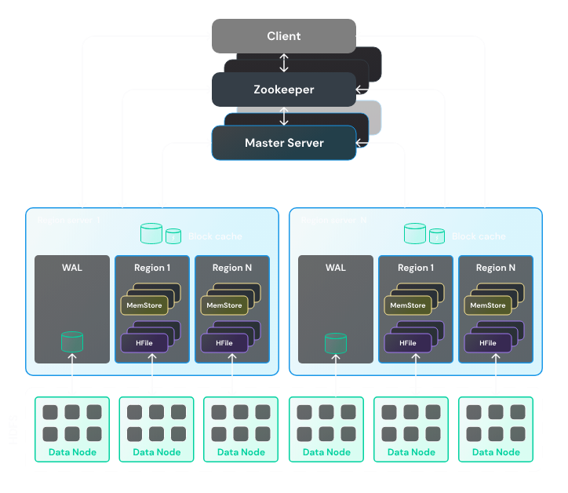
HBase architecture
HBase architecture is based on the following components:
  Region Server. It serves one or more Regions — ranges of rows, stored together. Each Region is served only by one Region Server. Region Servers are also called HRegionServers. A Region Server contains multiple components, some of them work on top of HDFS, using it as a persistent data storage.
  Master server. It is a main server responsible for managing an HBase cluster. It is similar to a NameNode in HDFS. A Master server manages distribution of Regions between Region Servers, maintains the registration of Regions, etc. It is also called HMaster. You can deploy several Master servers in your cluster: one active and one or more standby.
  ZooKeeper. It is a special service designed to manage configurations and synchronization of services. It is used to coordinate actions between HBase services.

Slide 4
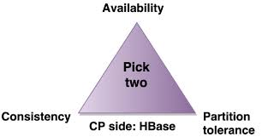
HBase and the CAP Theorem
HBase is a CP (Consistency + Partition Tolerance) system.
It guarantees that a client will always read the most recently written value.
This strong consistency is achieved by having a single RegionServer responsible for a given data range.
This makes it a good fit for Big Data use cases where data accuracy is a strict requirement.

Slide 5
The HBase Data Model
HBase stores data in a table-like structure, but it's very different from traditional databases.
Structure:
Table → Rows → Column Families → Columns → Versions (timestamps)
Row: Identified by a unique Row Key.
Column Family: A group of related columns stored together.
Version: Each data cell can have multiple versions (by timestamp).
Designed for scalability and sparse datasets — good when not every row has all columns.

Slide 6
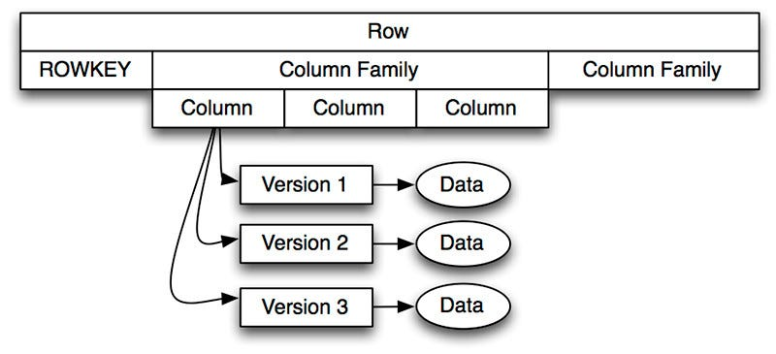
The Importance of the Row Key
The Row Key uniquely identifies a row.
Data is sorted by Row Key for fast lookups.
It controls data distribution across the cluster.
A bad Row Key design can slow down performance (e.g., timestamp-only keys = hotspotting).
The Row Key helps HBase find data quickly because all rows are sorted by Row Key, enabling fast lookups and efficient data access.

Slide 7
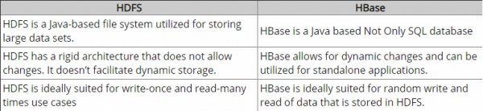
HBase vs. HDFS

Slide 8
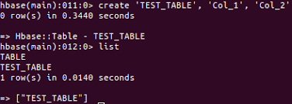
Interacting with HBase
You can work with HBase through:
hbase shell (command line)
Java API (main programmatic access)
REST/Thrift/Avro (for web or external systems)
Python (e.g., using happybase)
Use commands like: put, get, scan, delete.

Slide 9
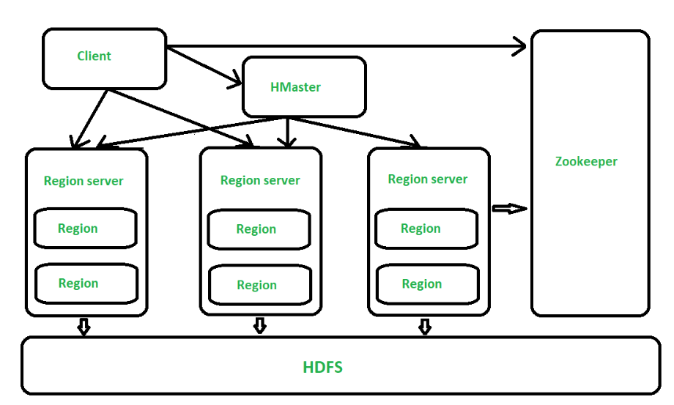
Master-Slave Architecture
HBase uses a master-slave architecture, coordinated by ZooKeeper.
The HMaster is responsible for administrative tasks and assigning data regions to servers ( Manages metadata and region assignments).
The RegionServers are the workhorses; they handle all client read and write requests.
This clear division of labor is a classic architecture for managing large-scale data systems.
Only one active HMaster at a time; others are standby for failover.

Slide 10
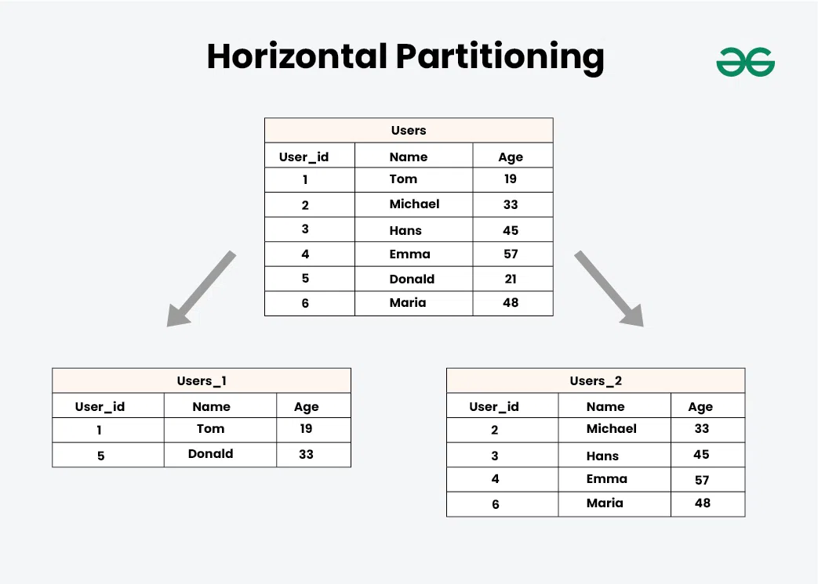
Regions: Horizontal Data Partitioning
A Region stores a range of rows from a table.
Tables are split horizontally into Regions as they grow.
Each RegionServer can serve multiple Regions.
This allows HBase to scale out as data increases.

Slide 11
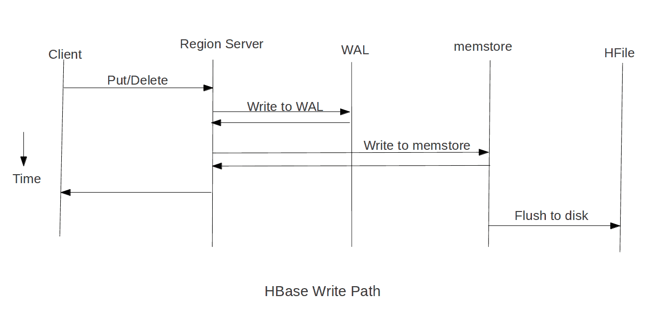
The Write Path: WAL (Write-Ahead Log)
WAL (Write-Ahead Log)
Logs every write before saving data.
Stored in HDFS to keep data safe if a server fails.
Helps recover data after crashes.
Fast because it only adds to the end of the log.
Purpose: If a RegionServer crashes, WAL ensures no data is lost.
WAL = No data loss

Slide 12
The Write Path: MemStore
Temporary storage in memory for new data.
Keeps data sorted for quick access.
When full, data is saved to disk as an HFile.
Once MemStore reaches a size limit, it’s flushed to disk as an HFile.
  First, HBase checks if the latest data is in memory (MemStore).
  If found, it's returned directly (fastest access).

Slide 13
The Write Path: HFiles (on HDFS)
Permanent data files stored on HDFS.
Created by flushing MemStore.
Files are sorted and unchangeable for fast reads.
Multiple files get merged over time to improve speed.
Over time, multiple HFiles are compacted to reduce read overhead.
  If not found in MemStore or BlockCache, HBase reads from HFiles on HDFS.
  Data is merged from multiple HFiles and versions if needed.
  May involve Bloom Filters and Block Indexes to speed up lookups.

Slide 14
The Read Path
HBase reads data in this order: memory → cache → disk, ensuring the most recent and fastest access possible.
To fulfill a read request, a RegionServer first checks the MemStore for the latest data.
If the data isn't in MemStore, it checks the BlockCache, which stores frequently accessed data blocks from HFiles.
If not found there, HBase reads from HFiles on HDFS using Bloom Filters and block indexes to speed up access.
This multi-layered read path ensures low-latency performance, making HBase ideal for real-time applications like analytics dashboards.

Slide 15
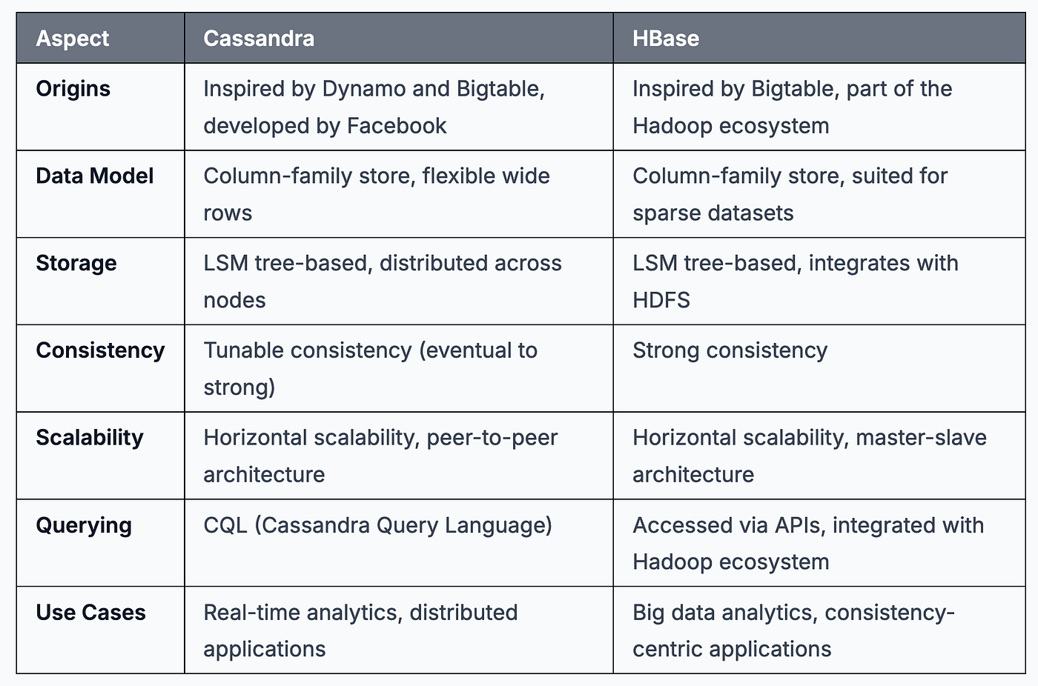
Cassandra vs. HBase

Slide 16
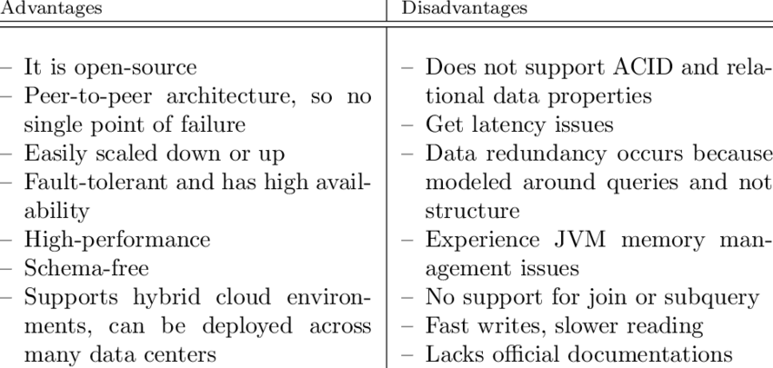
HBase: advantages and disadvantages

